Slide 1
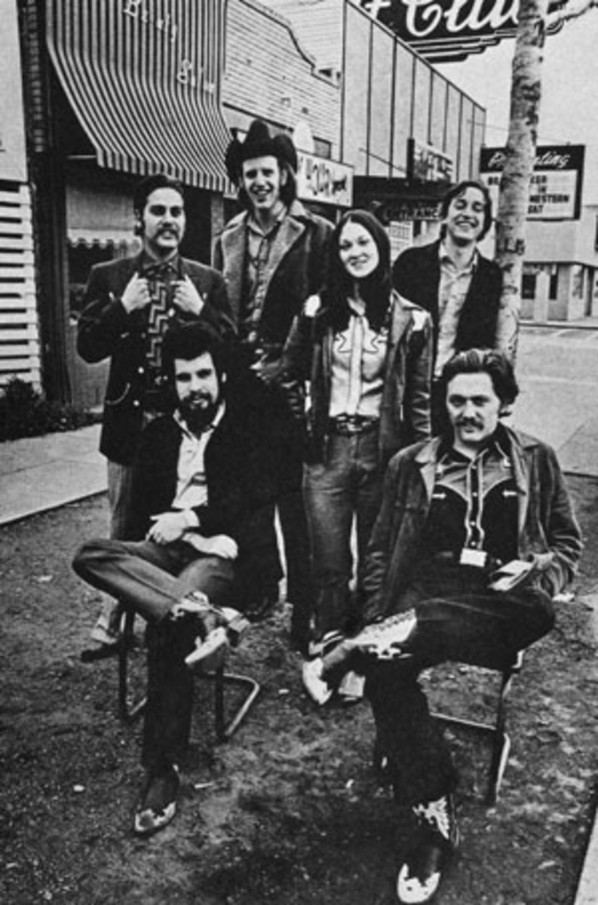
The Western Swing Resurgence
Western Swing and Cowtown
Course 19MM40
TCU Extended Education

Slide 2
The Western Swing Resurgence
Some artists who helped bring back the “sound”:
Asleep At The Wheel
Original Texas Playboys
Tommy Allsup
Merle Haggard
Willie Nelson
Glen Campbell
George Strait
Clay Walker
Brad Paisley
The Dixie Chicks

Slide 3
Willie Nelson

Slide 4
Country Favorites – Willie Nelson
Recorded in 1966
Album of his favorite covers
Much like his second Liberty Records album – strong Western Swing influence
Nelson was making regular appearances on Ernest Tubb’s TV show
Led to using The Texas Troubadors as his backup band

Slide 5
Country Favorites – Willie Nelson
Willie Nelson – guitar, vocals
Buddy Charleton – pedal steel
Jack Drake – bass
Jack Greene – drums
Wade Ray – fiddle
Leon Rhodes – guitar
Hargus “Pig” Robbins – piano
Cal Smith – rhythm guitar
James Wilkerson – bass, vibraphone

Slide 6
Country Favorites – Willie Nelson
“Jazzy” and “uptempo”
Included Western Swing numbers such as:
Columbus Stockade Blues
My Window Faces the South
San Antonio Rose
Home in San Antone
Known as a “fine artistic achievement” for Nelson, despite not necessarily mainstream

Slide 7
Merle Haggard

Slide 8
Merle Haggard
A Tribute to the Best Damn Fiddle Player in the World (or, My Salute to Bob Wills)
Released in 1970
Included personnel from The Texas Playboys
Johnnie Lee Wills
Eldon Shamblin
Tiny Moore
Joe Holley
Johnny Gimble
Alex Brashear
Produced by Earl Ball…

Slide 9
Merle Haggard
The album was an inspiration to other artists
Asleep At The Wheel
Commander Cody
Recorded all Bob Wills & The Texas Playboys tunes
Stayed true to original arrangements
Stuck with the “authenticity” of the genre
Would continue to collaborate with Western Swing artists throughout his career

Slide 10
Asleep At The Wheel then…

Slide 11
Asleep At The Wheel now…

Slide 12
Asleep At The Wheel
Started in 1970 in Paw Paw, WV
Currently based in Austin, TX
In the early days, opened for Alice Cooper and Hot Tuna!
Eventually ended up in ATX after Willie Nelson convinced them!
Currently have nine Grammys

Slide 13
Asleep At The Wheel
Album of significance:
Texas Gold (1975)
“Letter That Johnny Walker Read” – reached top 10 in 1975
“Best Country Western Band” by Rolling Stone (1977)
The 80’s –
The band began winning Grammys…

Slide 14
Asleep At The Wheel
A Tribute to the Music of Bob Wills and The Texas Playboys (1993)
Included Merle Haggard, Tommy Allsup, Willie Nelson, Lyle Lovett, Dixie Chicks, Dwight Yoakum, Tim McGraw, Shawn Colvin, Squirrel Nut Zippers, and others
Has toured with George Strait, Bob Dylan
Members and former members also have great solo success
Cindy Cashdollar, Jason Roberts, Emily Gimble, Chris O’Connell, Maryann Price, Katie Shore

Slide 15
Glen Campbell

Slide 16
Glen Campbell
Born and raised in Delight, Arkansas
Early musical development singing with his brothers and family
Performances on Austin City Limits with Johnny Gimble
Particularly loved to revive old folk melodies, western, and western swing
“I Want to Be Wanted”
“San Antonio Rose”
“Wildwood Flower”
“Barbara Allen”

Slide 17
Dixie Chicks then…

Slide 18
Dixie Chicks now…

Slide 19
Dixie Chicks
Formed in Dallas, TX
Laura Lynch, Martie and Emily Erwin, Robin Lynn Macy
Early influences include country, western, western swing, fiddle tunes, and bluegrass
“Thank Heavens For Dale Evans” (1990)
Laura Lynch left the group in 1995, and Natalie Maines was added

Slide 20
Dixie Chicks
Collaboration with Asleep At The Wheel (2000)
“Roly Poly” was originally recorded in 1945 by Bob Wills
Exposing Western Swing to a more mainstream audience! ☺

